Slide 1
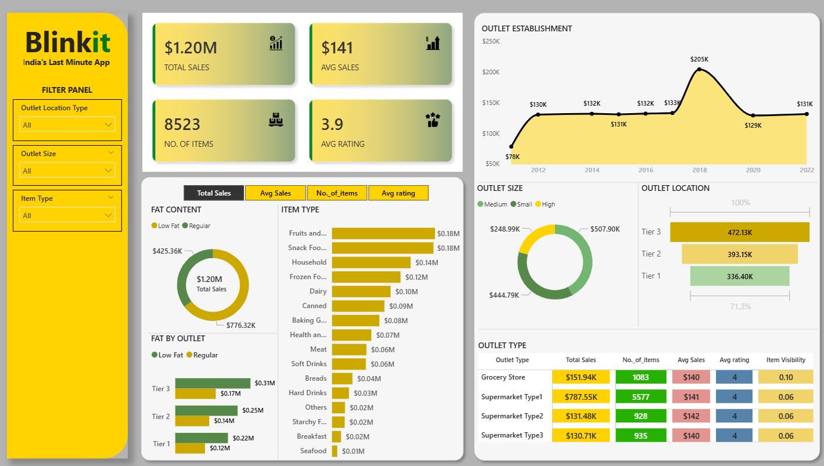

Slide 2
Blinkit
India’s Last Minute App
STEPS IN PROJECT:
Requirement Gathering/ Business Requirements.
Data Walkthrough.
Data Connection.
Data Cleaning/ Quality Check.
Data Modelling.
Data Processing.
Dax Calculation.
Dashboard Lay outing.
Charts Development and Formatting.
Dashboard/ Report Development.
Insight Generation.

Slide 3




Blinkit
India’s Last Minute App
BUSINESS REQUIREMENTS:
To conduct a comprehensive analysis of Blinkit’s sales performance, customer satisfaction and inventory distribution to identify key insights and opportunities for optimization using various KPI’s & visualizations in Power BI.
KPI Requirements:
Total Sales: The overall revenue generated from all items sold.
Avg. Sales: The avg. revenue per sale.
Number of items: The total count of different items sold.
Avg. rating: The avg. customer rating for items sold.

Slide 4
Blinkit
India’s Last Minute App
BUSINESS REQUIREMENTS:
Chart Requirements:
Total Sales by Fat Content:
Objective: Analyze the impact of fat content on total sales.
Additional KPI Metrics: Assess how other KPIs(Avg sales, No. of items, avg rating) vary with fat content.
Chart Type: Donut Chart
Total Sales by item type:
Objective: Identify the performance of diff. item types in terms of total sales.
Additional KPI Metrics: Assess how other KPIs(Avg sales, No. of items, avg rating) vary with fat content.
Chart Type: Bar Chart
Fat Content by outlet for total Sales:
Objective: Compare total sales across diff. outlets segments by fat content.
Additional KPI Metrics: Assess how other KPIs(Avg sales, No. of items, avg rating) vary with fat content.
Chart Type: Stacked Column Chart

Slide 5
Blinkit
India’s Last Minute App
BUSINESS REQUIREMENTS:
Chart Requirements:
Total Sales by Outlet Establishment:
Objective: Evaluate how the age or type of outlet establishment influences total sales.
Chart Type: Line Chart
Sales by Outlet size:
Objective: Analyze the correlation between outlet size and total sales.
Chart Type: Donut/Pie Chart.
Sales by Outlet Location:
Objective: Assess the geographic distribution of sales across different locations.
Chart Type: Funnel Map.
All metrics by Outlet Type:
Objective: Provide a comprehensive view of all key metrics(Total Sales, Avg sales, No. of items, avg rating).
Chart Type: Matrix Card.

Slide 6
Blinkit
India’s Last Minute App
ANALYSIS:
In process of analysis to the Blinkit data we got sales of item in Blinkit app were consistently increasing with good customer ratings, and inventory of blinkit company has different varieties of product with all kinds of portions in food for distribution.
KPI Analysis:
Total Sales: The overall revenue generated is $1.20M for all items sold .
Avg. Sales: The avg. revenue per sale is $141.
Number of items: The total count of different items sold 8523.
Avg. rating: The avg. customer rating for items sold is 3.9 overall.

Slide 7
Blinkit
India’s Last Minute App
Charts Analysis:
Total Sales by Fat Content:
The impact of fat content on total sales is more of low-fat products compared to regular products
Average sales is more of regular products then low-fat products.
Company have a good margin on regular products as they are sold less in numbers but have high sales value.
Total Sales by item type:
After observing the performance of different item types as per total sales the most sold item type is Fruits and Vegetables above all other items.
Average sales is more of household item types.
Fat Content by outlet for total Sales:
There are 3 tier segment of outlets in which low-fat products have more sales than regular products. In all 3 tiers, the most consumption of low-fat products overall has tier 3.
As per the average sales is concern regular products have overall bit higher sales then low-fat.
In every tier maximum items sold are of low-fat products compared to regular products.

Slide 8
Blinkit
India’s Last Minute App
Charts Analysis:
Total Sales by Outlet Establishment:
Overall, the total sales of outlet establishment was at peak in 2018 with $205K and had least sales in 2011 about $78K. Rest of the years it maintained a constant sales around $131K.
Sales by Outlet size:
As per the total sales of outlet size most sales are in medium size outlet ($507.9K), then small size outlet ($444.79K) and big outlet ($248.99K). So, we can say that mostly preferred and profitable outlet size is medium.
Sales by Outlet Location:
Analysis says total sales as per outlet location says the highest sales were in Tier 3 with $472.13K, then Tier 2 with $393.15K and at last Tier 1 with $336.40K.

